Slide 1
New pills, new rules What’s next for ARVs?
James Nuttall
Paediatric Infectious Diseases Subspecialist
Red Cross War Memorial Children’s Hospital,
University of Cape Town
Bhekisisa webinar 7 December 2022

Slide 2
Disclosures
HIV guidelines committee, Technical Working Group, National Department of Health, South Africa

Slide 3
Outline
The big picture & 95-95-95 targets
Key updates for children in 2023 SA HIV guidelines
Better ARV drugs & formulations for young children
Scored dispersible tablets: ABC/3TC & DTG
4-in-1 ABC/3TC/LPV/r capsule containing granules for dispersion in water/soft food
Starting ART and switching for those currently on ART
Treatment literacy & creating demand for better treatment

Slide 4
The numbers
Globally, since 2010, new HIV infections among children have declined by 52%, from 320 000 in 2010 to 160 000 in 2021
1.7 million children are living with HIV
In 2021, 52% of children had access to treatment vs 76% of adults (>15 yrs of age)
UNAIDS Global HIV statistics

Slide 5
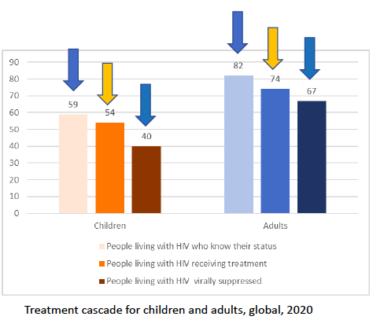

Slide 6
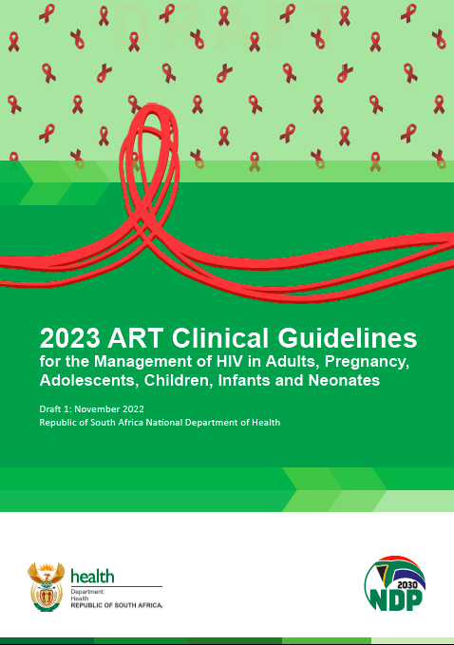

Slide 7
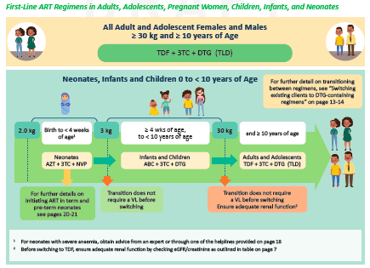

Slide 8
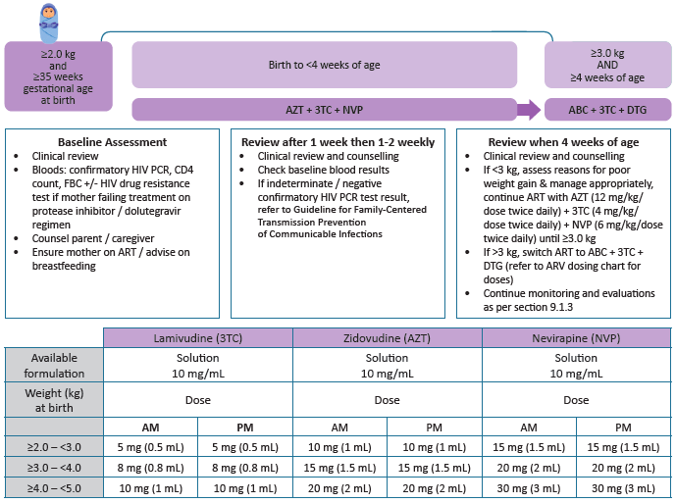

Slide 9
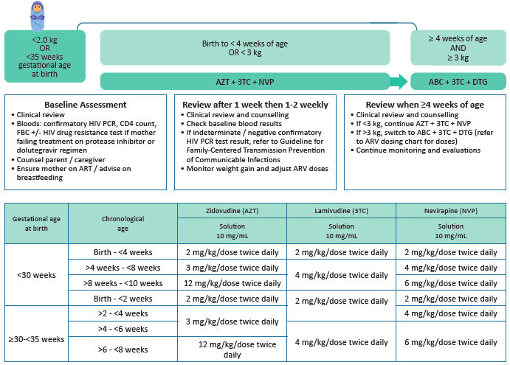

Slide 10
Slide courtesy M. Archary

Slide 11
ARVs for young children What’s new
Individual drug liquid formulations
Large volumes
Taste bad, poorly tolerated (spitting, vomiting)
Some require refrigeration
Expensive
Often twice a day dosing (Lopinavir/ritonavir)
Adverse effects
Dispersible scored small combination tablets / Capsules containing granules for dispersion
Disperse in water or small amount of food
Better taste
Easier to store
Cheaper
Once daily dosing
More effective
Safer

Slide 12
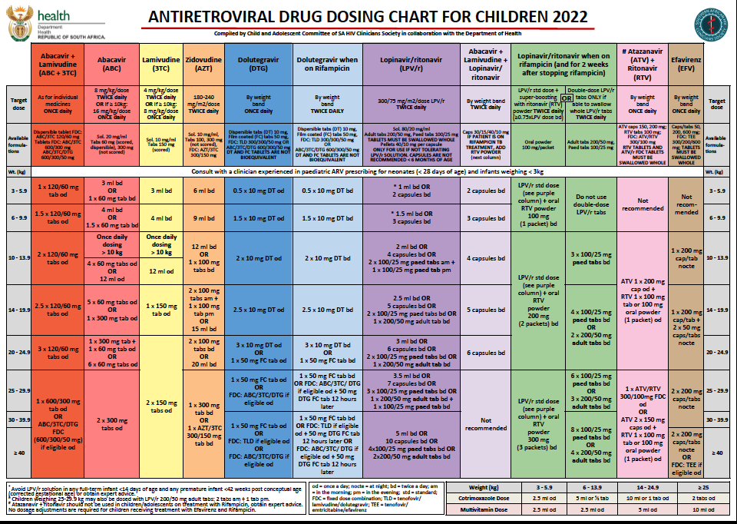
https://sahivsoc.org/Subheader/Index/sahcs-guidelines
http://www.mic.uct.ac.za/

Slide 13
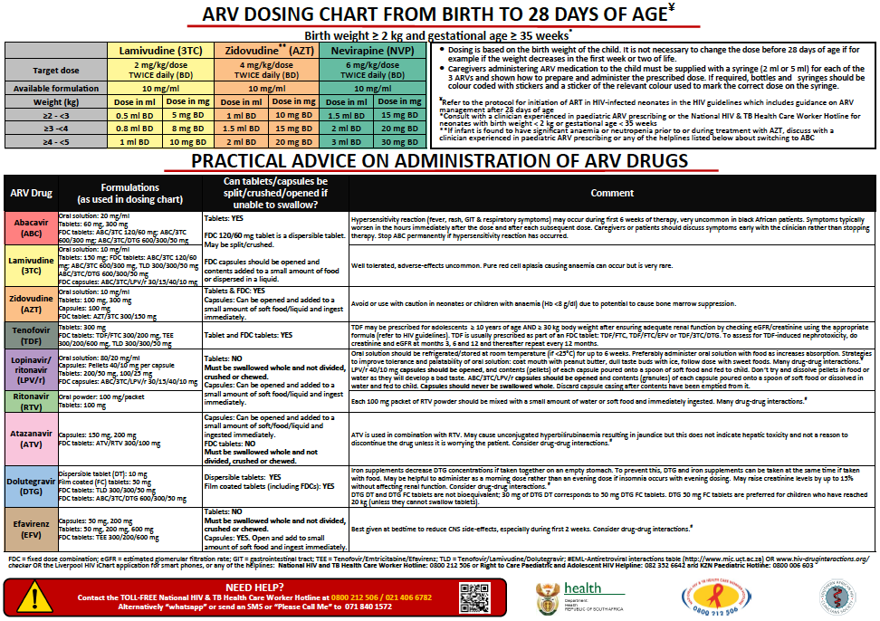

Slide 14
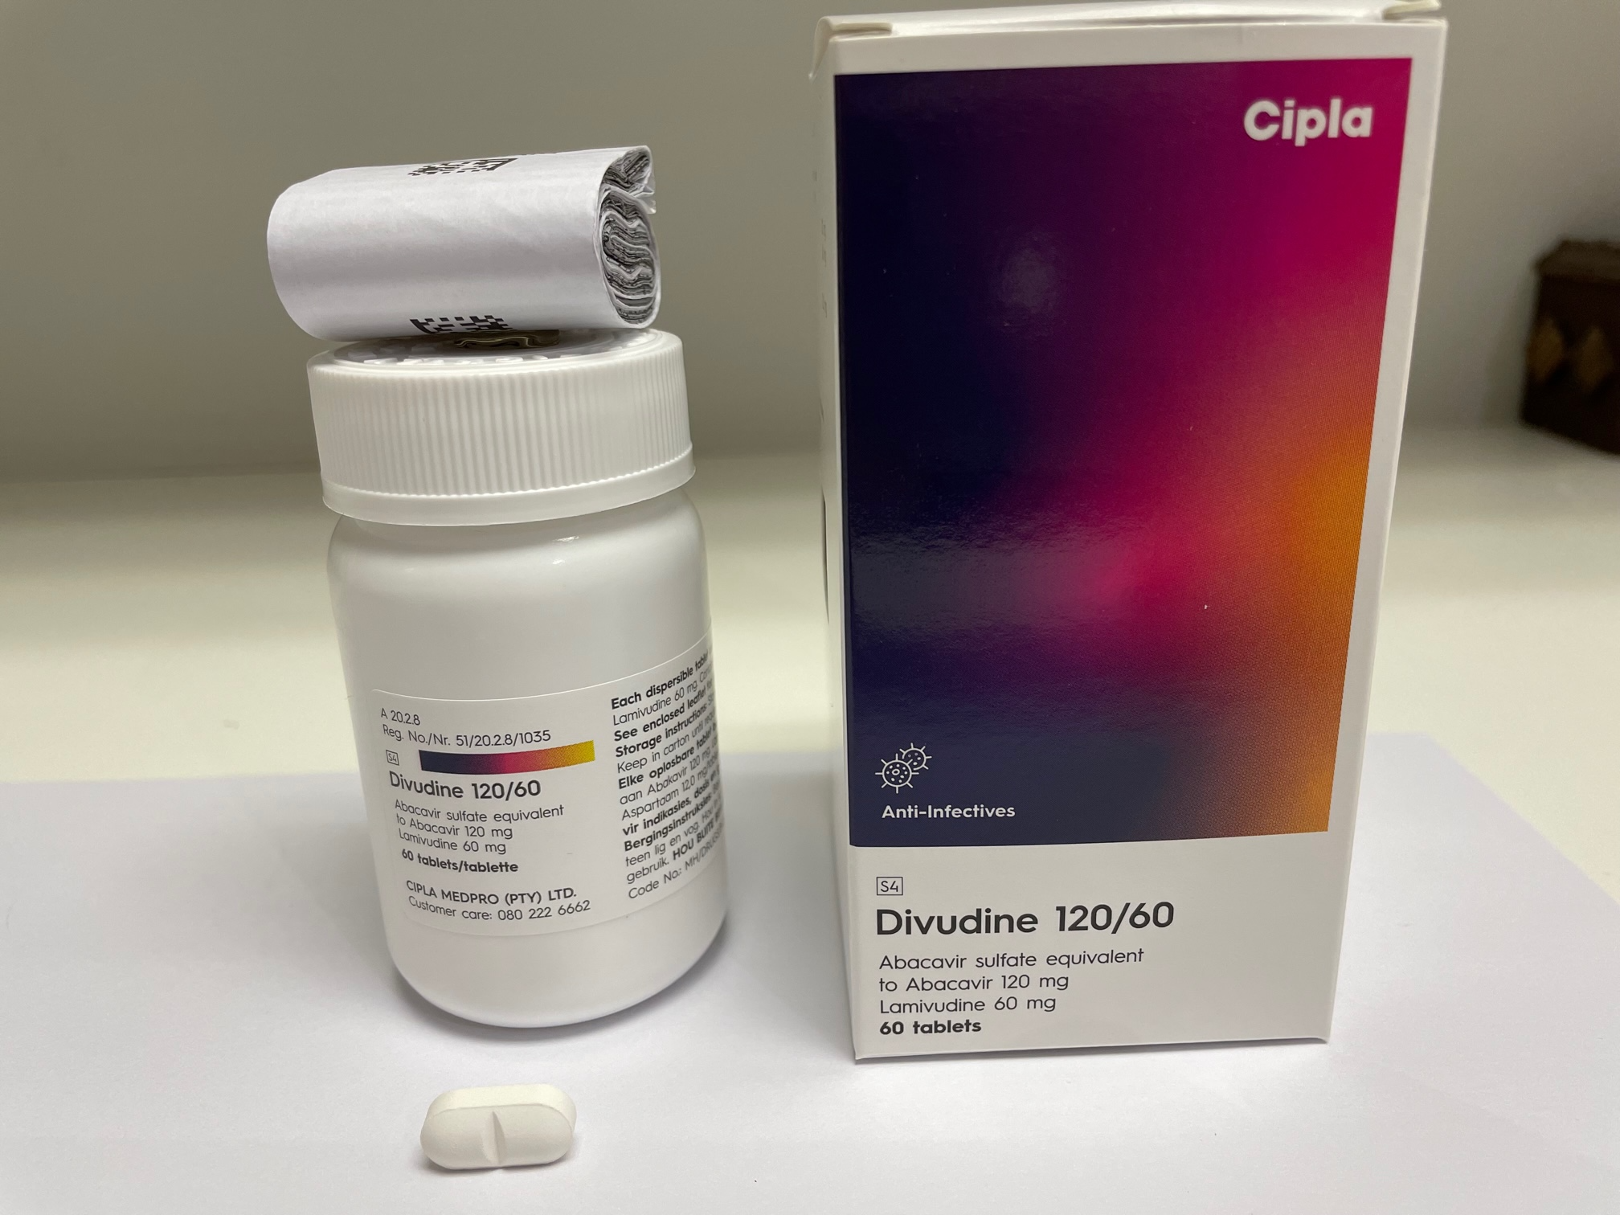
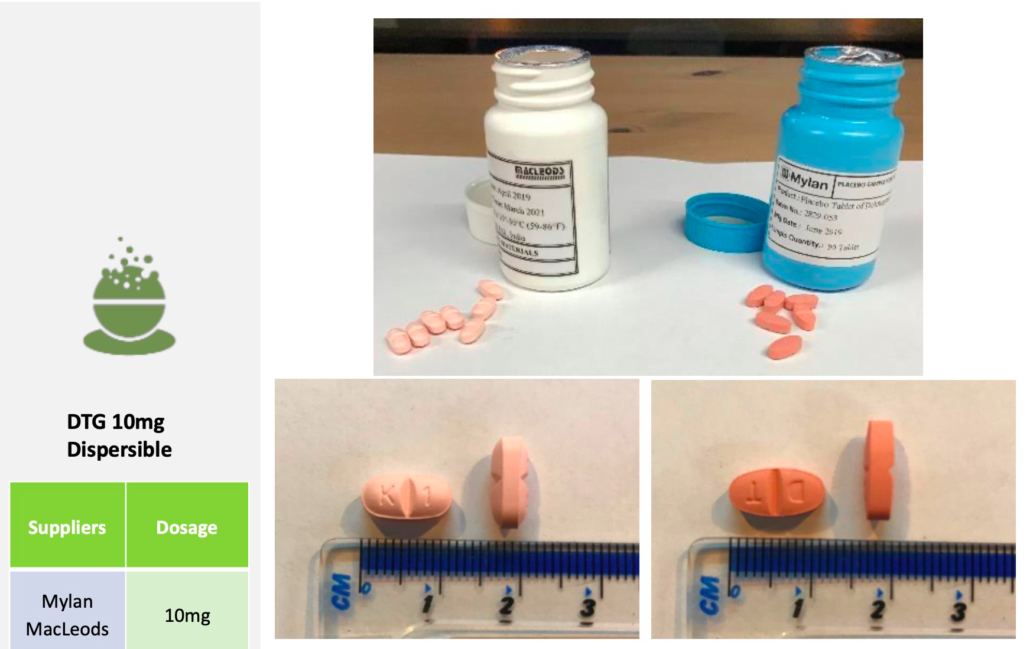
Abacavir + lamivudine
Scored dispersible tablet
4-in-1 ABC/3TC/LPV/r granules

Slide 15
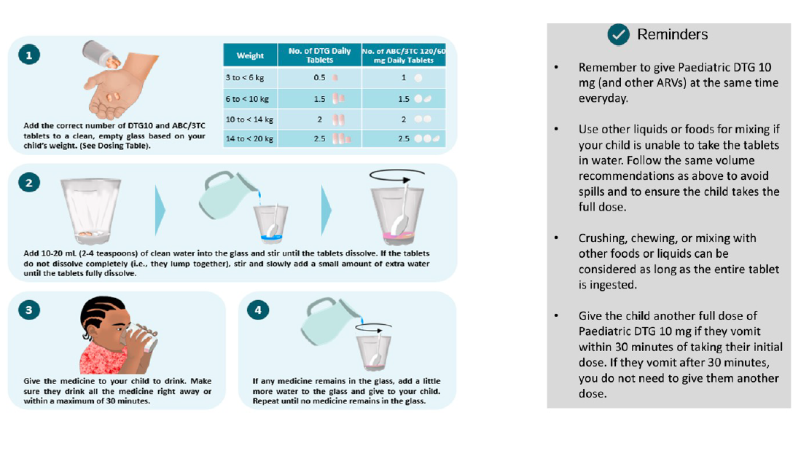

Slide 16
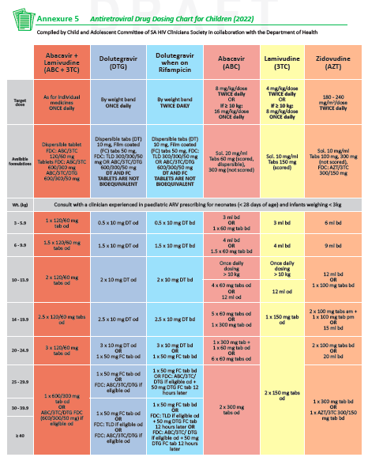

Slide 17
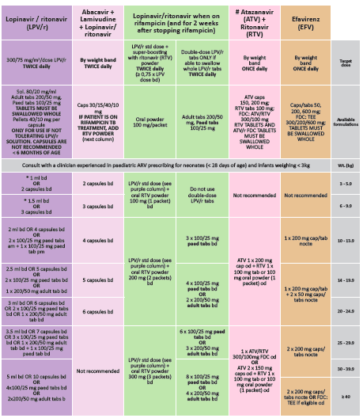

Slide 18
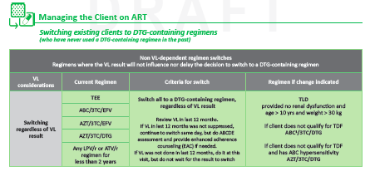

Slide 19
Treatment literacy & creating demand for accessing better ARV treatment
Health care providers
Prescribers (doctors & nurses)
Pharmacists
Counsellors
Patients – parents / caregivers / adolescents
Treatment Action Campaign, Media, other civil society organisations

Slide 21
Paediatric DTG advocacy video for communities
https://www.newhivdrugs.org/post/pdtg-advocacy-video-for-communities-english-french
Clinton Health Access Initiative: HIV new product introduction toolkit

Slide 22
Drugs for Neglected Diseases initiative (DNDi) Best science for the most neglected
https://dndi.org/diseases/paediatric-hiv/
An easy-to-administer strawberry-flavoured combination of four ARV medicines
Partnership with Cipla
Registered in SA in June 2022
https://youtu.be/ijnTlCZ-Ak8

Slide 23
Acknowledgements
Southern African HIV Clinicians Society
Juliet Houghton
Child & adolescent committee members
Medicines Information Centre / National HIV & TB Health Care Worker Hotline
Anri Uys
National Department of Health
HIV guidelines committee & technical working group
Jeannette Wessels

