Slide 1
Adult Antiretroviral Therapy Guidelines 2023 Update

Slide 2
Why an update now?
The shift to “TLD”, and away from other, older regimens.
New drugs and drug combinations.
Correcting the narrative on dolutegravir.
Modernise and update the latest advice and approaches.

Slide 3
The shift to “TLD”
Tenofovir-lamivudine-dolutegravir
Single, coformulated tablet.
Very well tolerated.
High “barrier to resistance”
Low cost

Slide 4
TLD
1st line TEE
2nd line PI
Simplifying 3rd line

Slide 5
Shift away from AZT and lopinavir/ritonavir
AZT (zidovudine)
Twice-daily
Side-effects
Now known to be inferior to TDF even in second-line therapy
Lopinavir/ritonavir
Twice-daily
Side-effects
Still required for some patients on TB treatment who need medication in this class.

Slide 6
Correcting the narrative on dolutegravir
Safe in pregnancy
Initial concerns from Botswana pregnancy registry data have gone away as further data accumulated, and no similar signal elsewhere in the world either.
Doesn’t cause weight gain
More weight gained when compared to efavirenz-based regimens, but this almost certainly isn’t dolutegravir’s doing.
Seems to be toxicity from efavirenz-based regimens in a subset of patients who (genetically) metabolise it slowly → higher efavirenz levels → preventing weight gain.

Slide 7
New drugs and drug combinations
Abacavir (ABC) + lamivudine + dolutegravir
Another good regimen available as a single tablet.
Co-formulated protease inhibitors: atazanavir/ritonavir, darunavir/ritonavir.
Fewer tablets required for patients on drugs of this class (protease inhibitors)
“TAF” – tenofovir alafenamide
Slightly more renal and bone friendly version of tenofovir (TDF), though with some other downsides that precluded frontline recommendation.

Slide 8
Synergy with Department of Health Guidelines
Conscious of the need for harmonisation where possible:
Easier for training and educational purposes
Patients shift between public and private sectors
Where there are differences, these are clearly indicated and a rationale given.

Slide 9
Getting the word out
PDF to download:
High quality document, small size (2.7 MB), no need for constant internet access.
Online website
Realtime, quick to update, optimised for both mobile devices and desktops
Webinars, training sessions
Downloadable posters
Treatment and monitoring algorithms

Slide 14
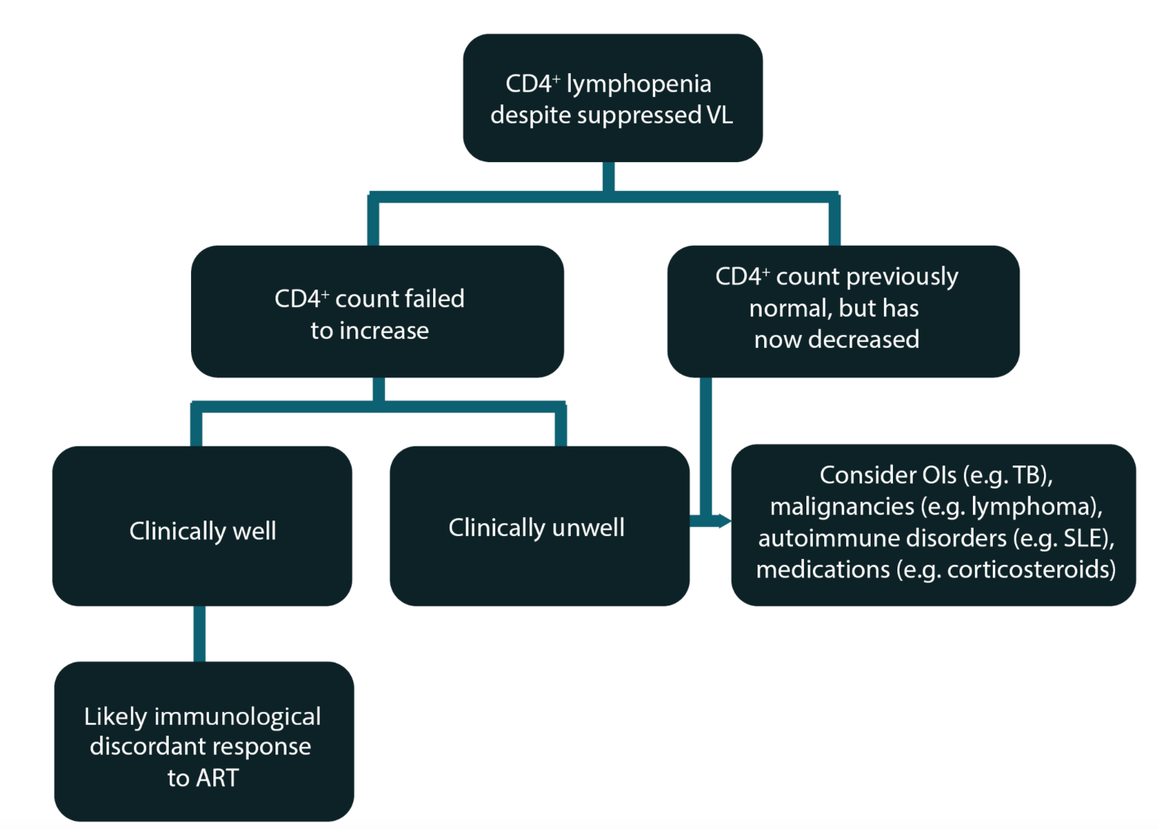

Slide 16
