Slide 1
National Health Insurance (NHI): Key updates

Slide 2
OUTLINE
Do South African enjoy UHC? - Where is the money?
Progress with the NHI Bill in the Portfolio Committee
Progress with establishment of the NHI Branch in NDOH

Slide 3
Progress with the NHI Bill in the Portfolio Committee
What are the health sector funding trends over the past 15 years? (Rm)
High level
More is spent in the private sector than the public sector since 2008
Private spending shows a linear increase
Public sector was almost linear until 2021/22

Slide 4
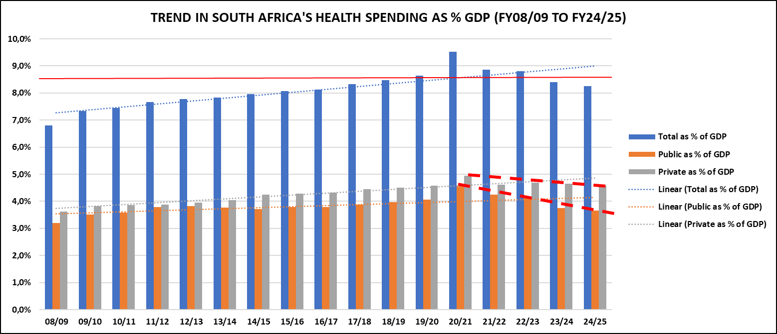
Progress with the NHI Bill in the Portfolio Committee
What are the health sector funding trends over the past 15 years? (%GDP)
High level
National spend currently is around 8,9%GDP (up from below 7% in 2008/09)
Both Public and Private spending increased as %’s of GDP until 2020/21 but both are decreasing, public faster than private – this is extremely worrying

Slide 5
Progress with the NHI Bill in the Portfolio Committee
What at the current health sector funding distribution?
High level
2021/22 total public sector spending on health is about R12bn less than private sector spending
The total expenditure in SA on health is approaching R550bn per annum (already beyond this with donor spending)
 | FY21/22
 | Rand (bn) | %
Total public sector health | 265 844 | 48,9%
Total private sector health | 277 402 | 51,1%
 | 543 246
Donors contribute R11 095bn, bringing total spend to R554 341bn

Slide 6
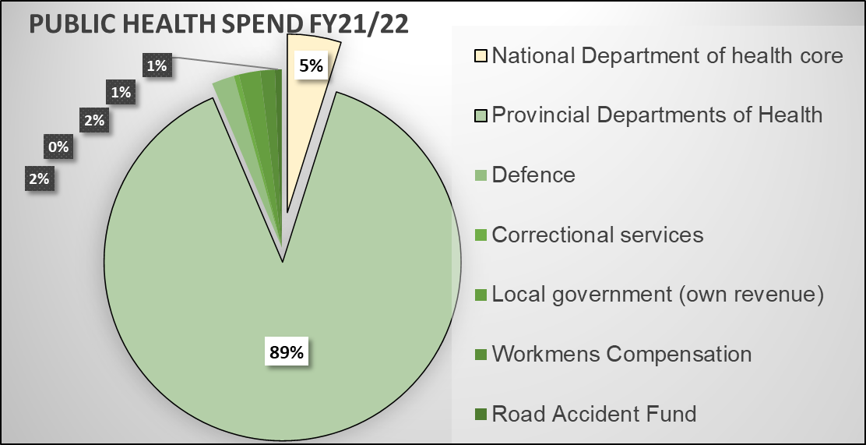
Progress with the NHI Bill in the Portfolio Committee
South Africa public sector funds in 2021/22
Most public health spending is in the provincial services
Even most national department allocations are in fact direct transfers to provinces in ‘conditional grants’
All other public allocations are small
* NDOH spend in FY2021/22 includes COVID response – reduces to R8,3bn in FY2023/24
 | FY21/22
 | Rand (bn) | %
National Department of health core | *12 947 | 4,9%
Provincial Departments of Health | 235 892 | 88,7%
Defence | 5 474 | 2,1%
Correctional services | 1 216 | 0,5%
Local government (own revenue) | 5 138 | 1,9%
Workmen's Compensation | 3 502 | 1,3%
Road Accident Fund | 1 675 | 0,6%
Total public sector health | 265 844

Slide 7
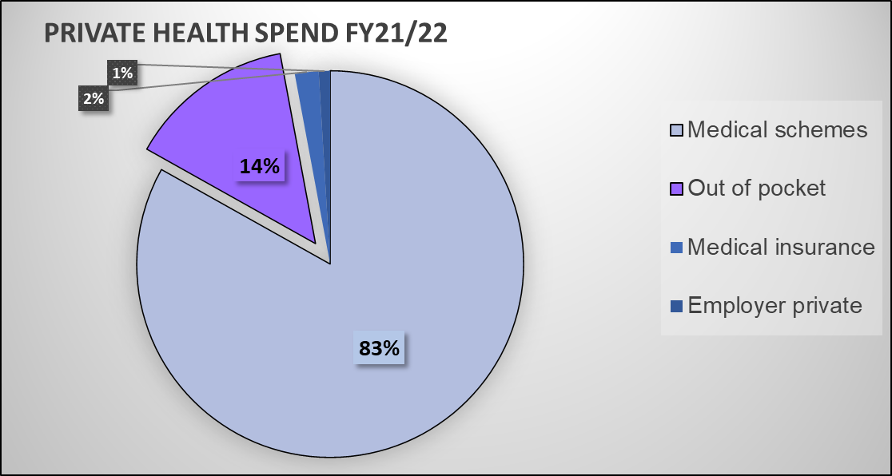
Progress with the NHI Bill in the Portfolio Committee
South Africa private sector funds in 2021/22
The bulk of private spending is through medical schemes
A sizeable portion (14%) is through ‘out-of-pocket’ spending (much is by medical scheme members for benefits not covered by their ‘packages’, but also by non-scheme members of the public)
 | FY21/22
 | Rand (bn) | %
Medical schemes | 230 618 | 83,1%
Out of pocket | 38 653 | 13,9%
Medical insurance | 5 501 | 2,0%
Employer private | 2 630 | 0,9%
Total private sector health | 277 402

Slide 8
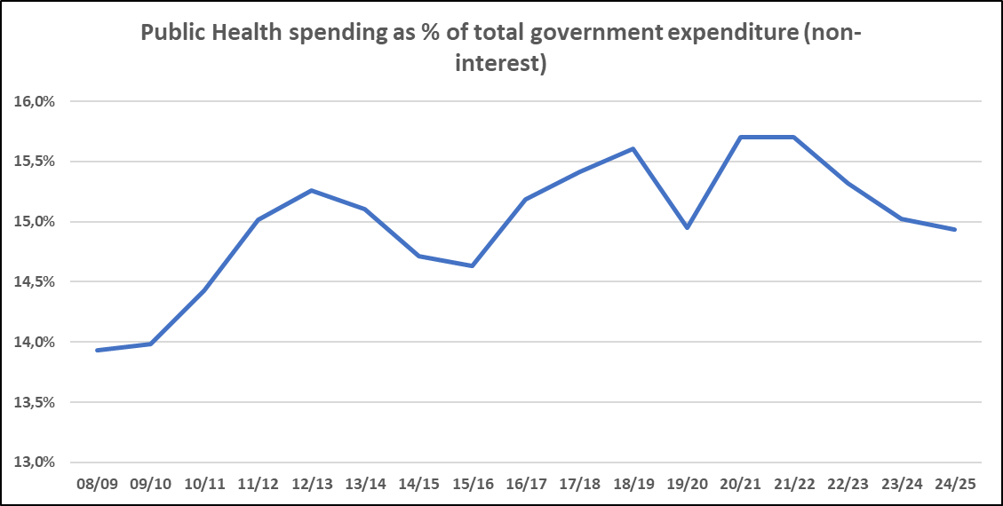
Progress with the NHI Bill in the Portfolio Committee
Does government spend enough on health?
High level
Spending by government on health has increased as a % of allocations from the fiscus (from 14% to 15,5% and now at around 15%)

Slide 9
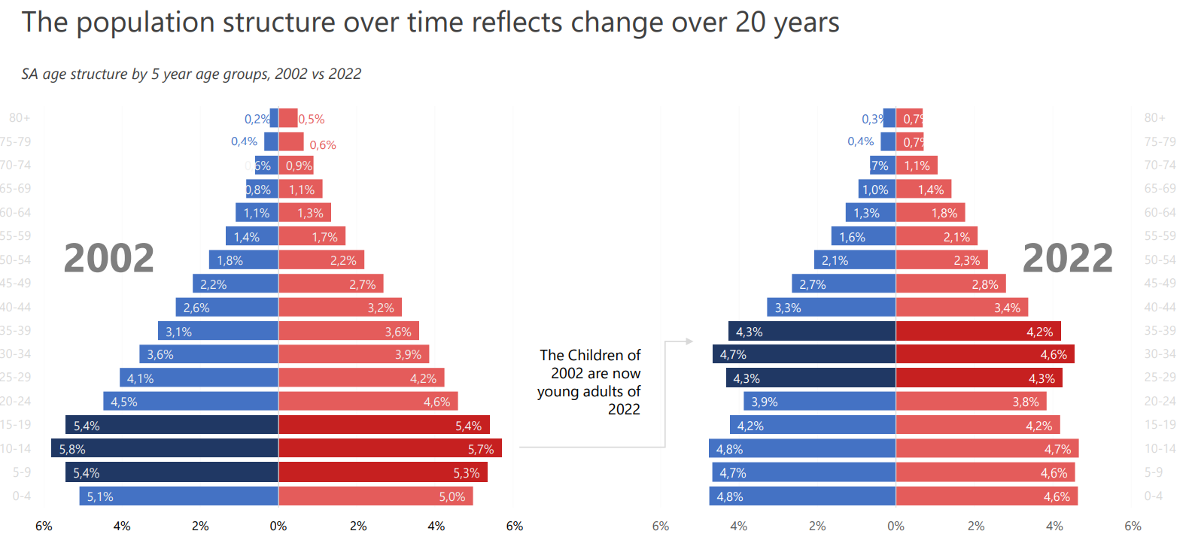
Planning ahead - the changing healthcare need profile
Population is increasing but at a slowed rate of increase
Reduced total fertility rate
Reduced under five mortality rate
Reduced crude death rate
Increased life expectancy
Young population will age and older population live longer
Changing needs for health care
Internal geographic and socio-economic maldistribution
SOURCE: StatsSA

Slide 10
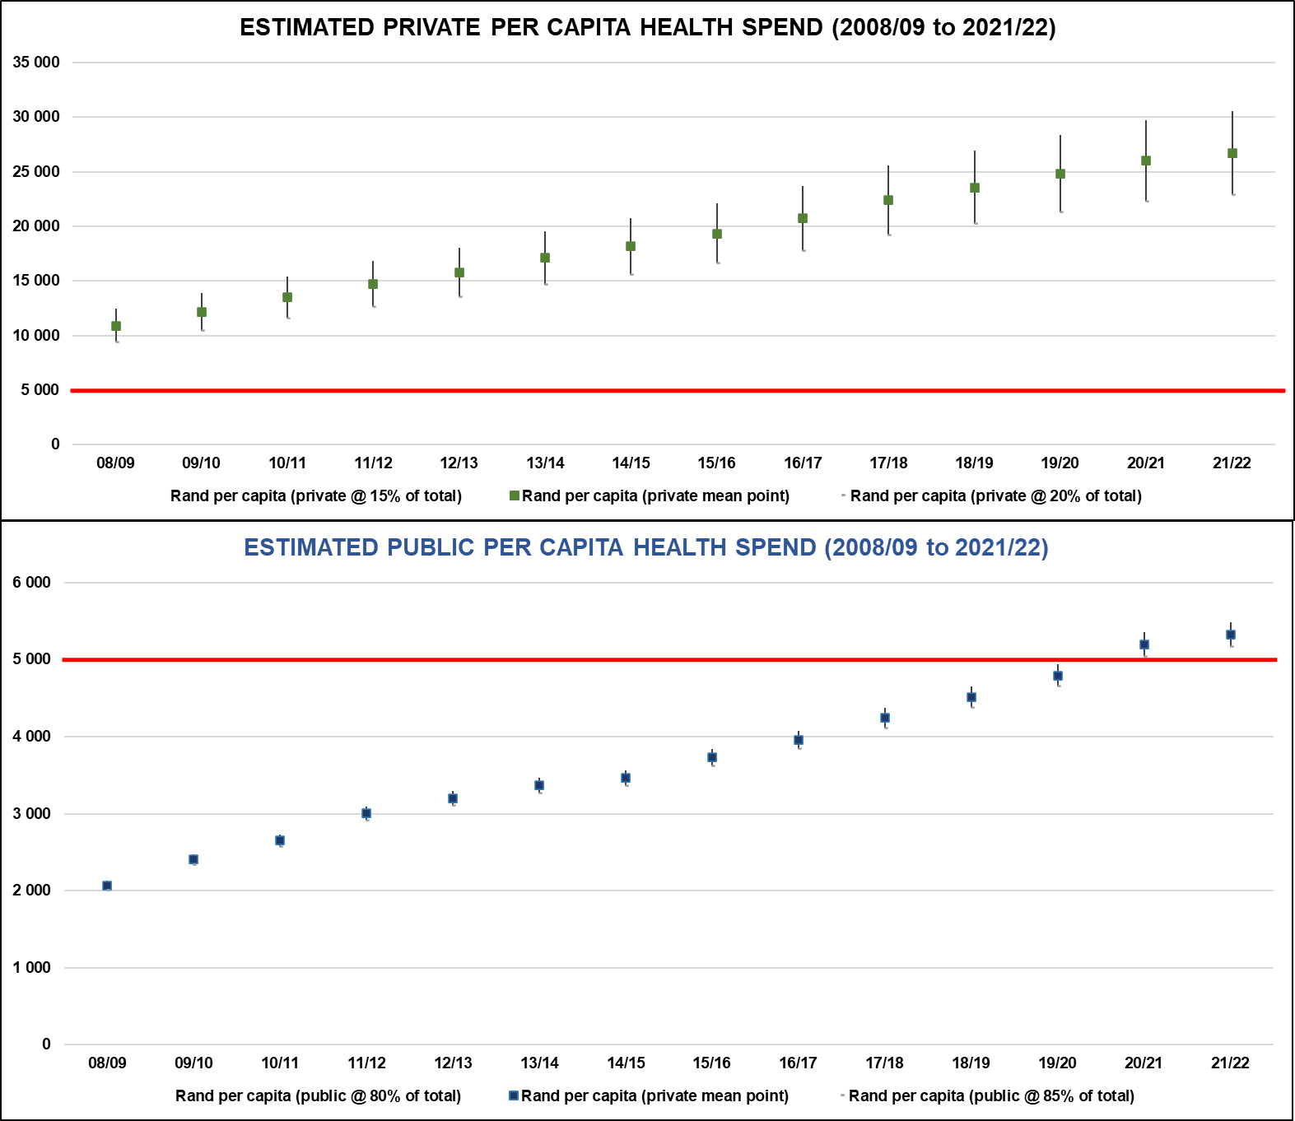
Progress with the NHI Bill in the Portfolio Committee
Per capita spending on Health 2008/09 to 2021/22
Rand per capita spend on health
public @ 80% and private at 20% of total
mean point Rand per capita
public @ 85% and private at 15% of total
2021/22 FY
Private spend per person is 5,0 times that of public
Range 4,4 to 5,6 times depending on proportion of the population regularly using private providers
Per capita spending on Health 2021/22
Rand per capita (private @ 15% of total) | R30 515
Rand per capita (private mean point) | R26 700
Rand per capita (private @ 20% of total) | R22 886
Rand per capita (public @ 80% of total) | R5 483
Rand per capita (private mean point) | R5 322
Rand per capita (public @ 85% of total) | R5 161

Slide 11
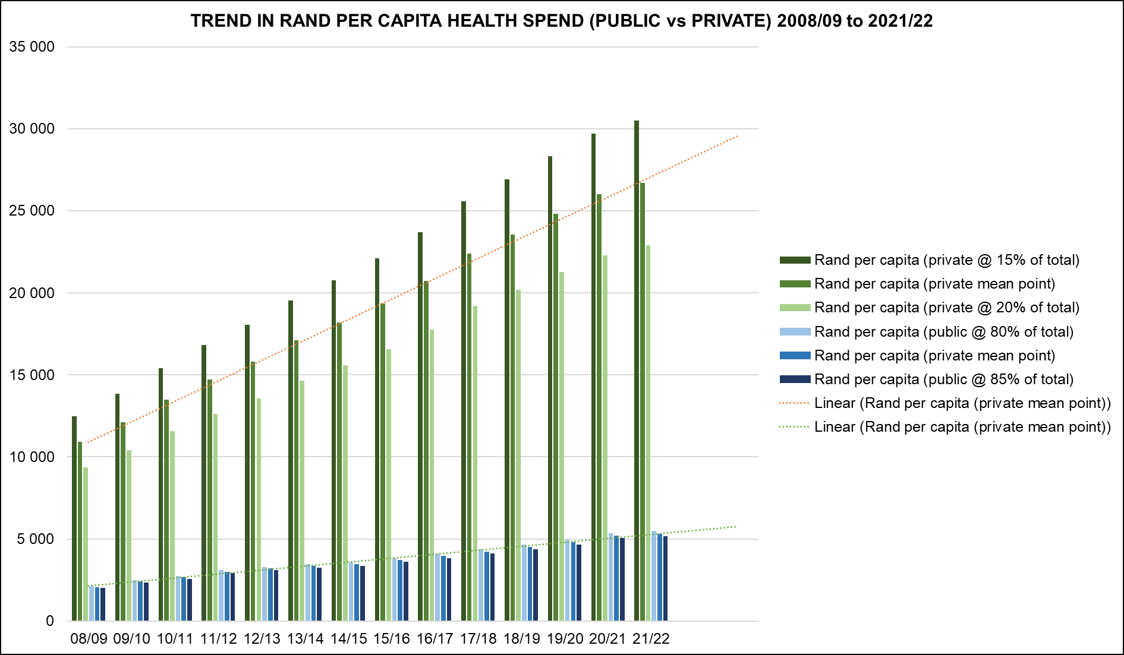
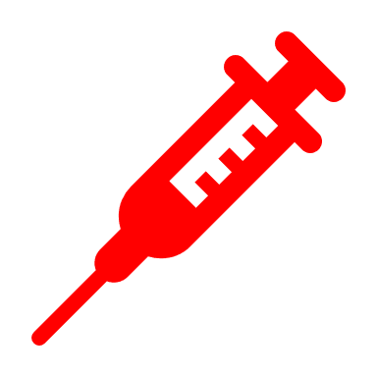
Progress with the NHI Bill in the Portfolio Committee
How big is this gap in per capita spending?
There is a growing gap in per capita spending
(R5000 vs R25 500) is the challenge
Collective per capita spend 2021/22 is R9 147
Resources (HR, technology and infrastructure, etc) follow the money
This is the gap that needs to be closed by NHI
If we spent:
private average of R26 700 per capita on every South African we would need an annual health budget of R1 618 178 420 565 (R1,6 trillion)
public average of R5 322 per capita on every South African we would need an annual health budget of R322 530 888 247 (R322,5bn)

Slide 12
National Health Insurance has fundamental implications for the National Health System:
“national health system” means the system within the Republic, whether within the public or private sector, in which the individual components are concerned with the financing, provision or delivery of health services (National Health Act)

Slide 13
Progress with the NHI Bill in the Portfolio Committee
Portfolio Committee concluded ‘clause-by-clause’ discussions on the Bill clauses
Hon Minister made introductory comments to NDOH response on 16 November 2022
NDOH responded on 30 November 2022
Chief State Law Advisor is busy with legal opinion on legality of the Bill
Early 2023 (probably Feb after SONA)
Prepare ‘A list’ amendments
Next step is consultation in the Provincial Legislatures led by the Select Committee of NCOP
Anticipate conclusion of the process in 2023

Slide 14
Transitional Functional NHI Branch (in NDOH)
Internal reorganisation in NDOH with shifting of functions between Branches (Current posts 95)
New components added as a result of the MPSA approvals
NHI Branch (5 Chief Directorates): 44 new posts advertised (1955 applications)
CHIEF DIRECTORATE: USER & SERVICE PROVIDER MANAGEMENT
7 new posts advertised
CHIEF DIRECTORATE: HEALTH CARE BENEFITS & PROVIDER PAYMENT DESIGN
6 new posts advertised
CHIEF DIRECTORATE: HEALTH PRODUCT PROCUREMENT
Currently AMD, PEE and Licensing ( posts)
CD: candidates have been for competency testing
3 new posts advertised
CHIEF DIRECTORATE: HEALTH SYSTEMS DIGITAL INFORMATION
Currently Dir: Health Information ( posts)
CD: Internal transfer almost concluded
25 new posts advertised
CHIEF DIRECTORATE: FRAUD MANAGEMENT
3 new posts advertised
Target for filling new posts is 70% filled by 31 March 2023

Slide 15
THANK YOU

